Slide 2
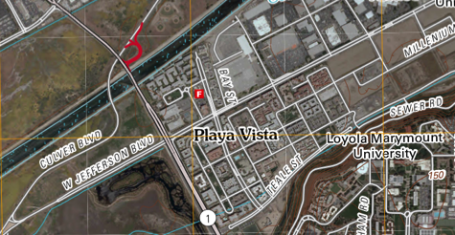
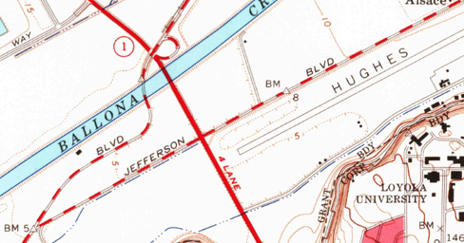
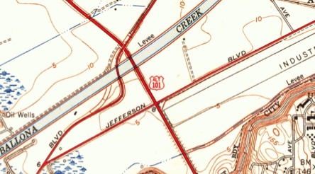
2012
1964
Exploiting Context in Cartographic Evolutionary Documents to Extract and Build Linked Spatial-Temporal Datasets
Editions in map series not independent
Change incrementally (updates)
Overlap in content
Can be used as training data for feature extraction!
1950

Slide 3
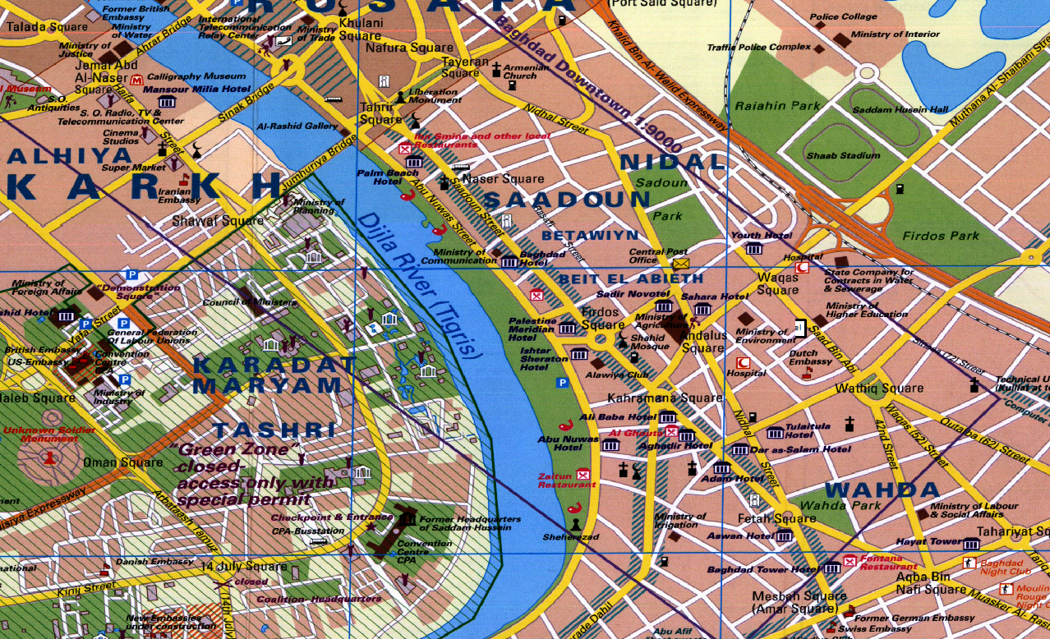
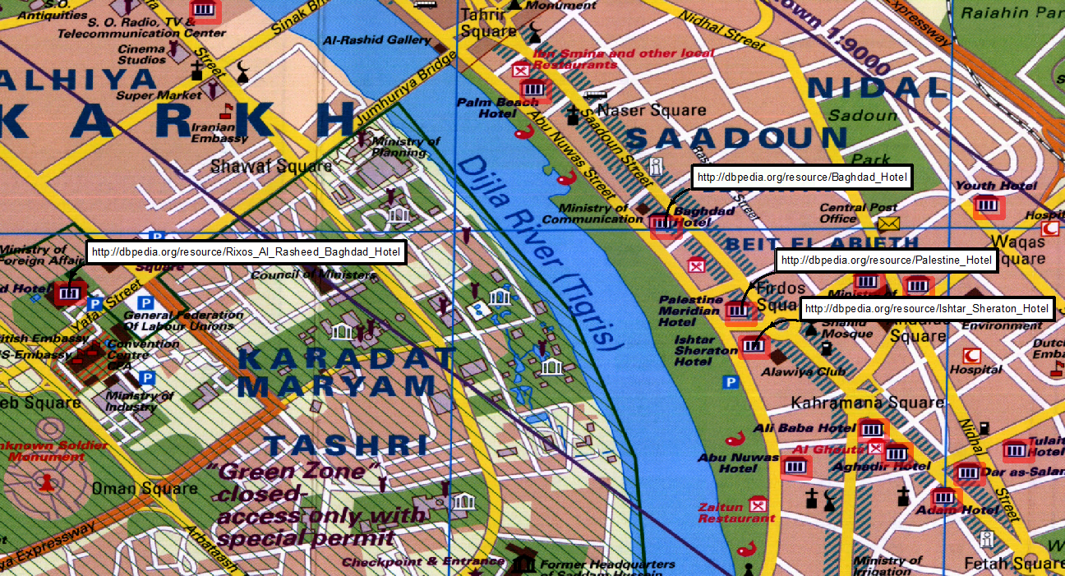
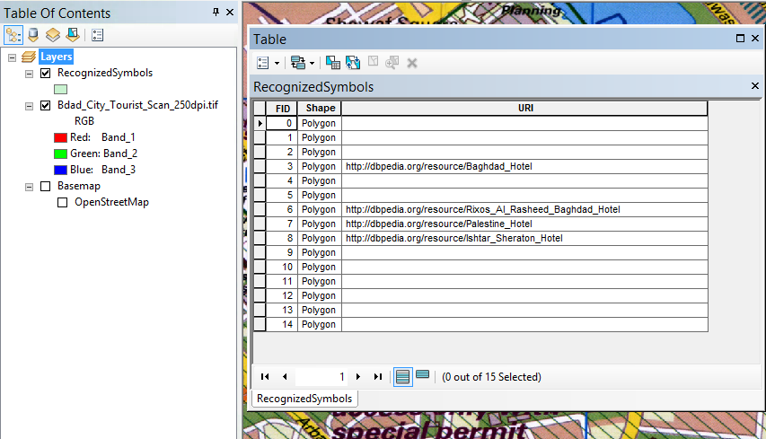

Slide 4

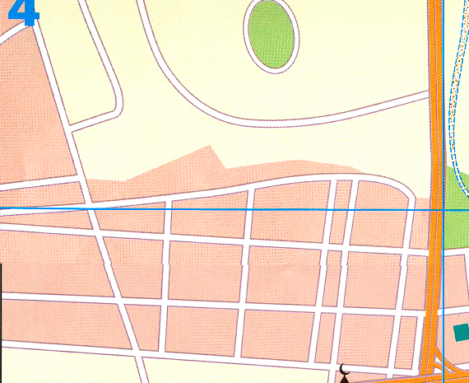
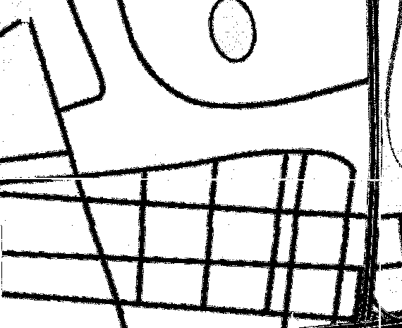
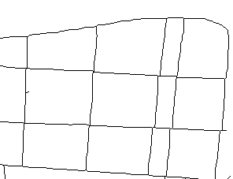
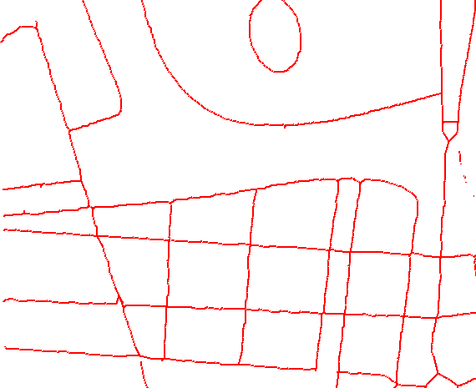
Extracting the road layer from a map image
Extracted road layer (raster)
Extracting road intersections and tracing road lines
Road vector data

Slide 5
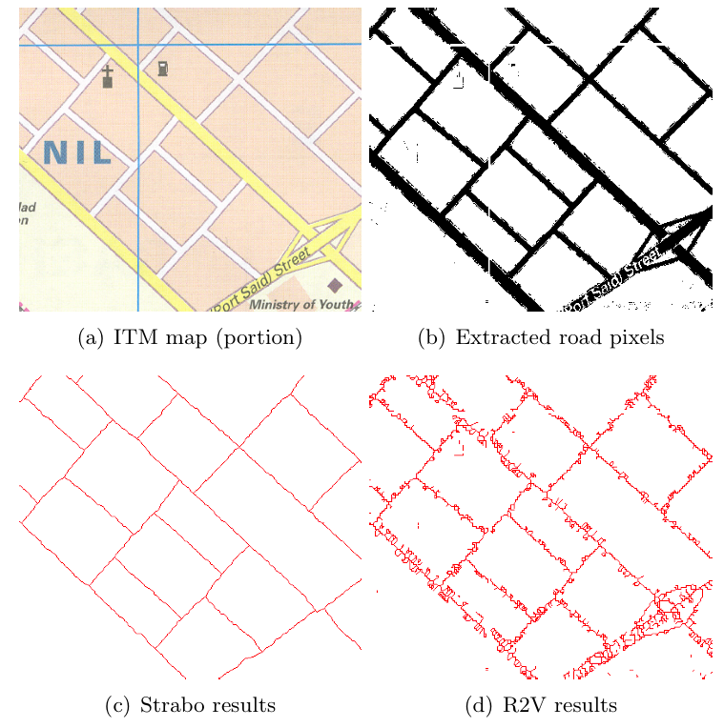
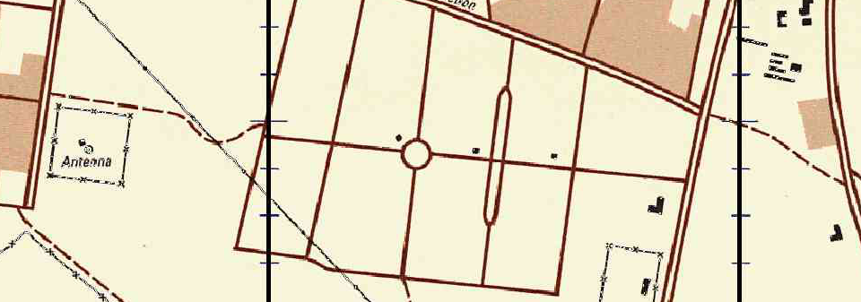
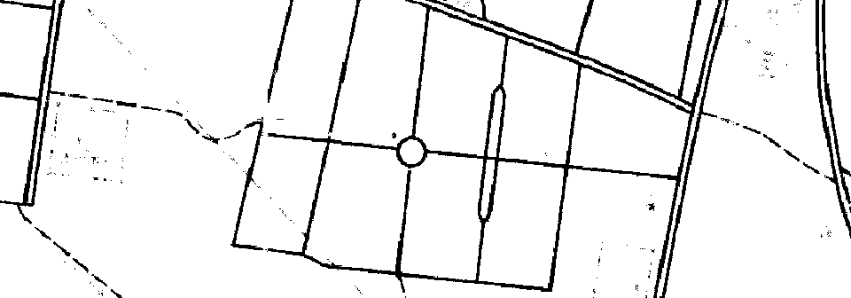
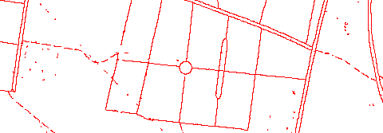
Example Road Vectorization Results
Notes:
Strabo is the name of our system. The results from Strabo are shown in the first and third column. The second column shows the results of R2V on the same map. As you can see from the results, R2V does poorly on this map due to the thickness of the roads. This can be fixed in R2V, but it requires significant effort to properly set the parameters. Strabo only requires a few example labels.

Slide 6
Example Road Vectorization Results
Notes:
Strabo is the name of our system. The results from Strabo are shown in the first and third column. The second column shows the results of R2V on the same map. As you can see from the results, R2V does poorly on this map due to the thickness of the roads. This can be fixed in R2V, but it requires significant effort to properly set the parameters. Strabo only requires a few example labels.

Slide 7
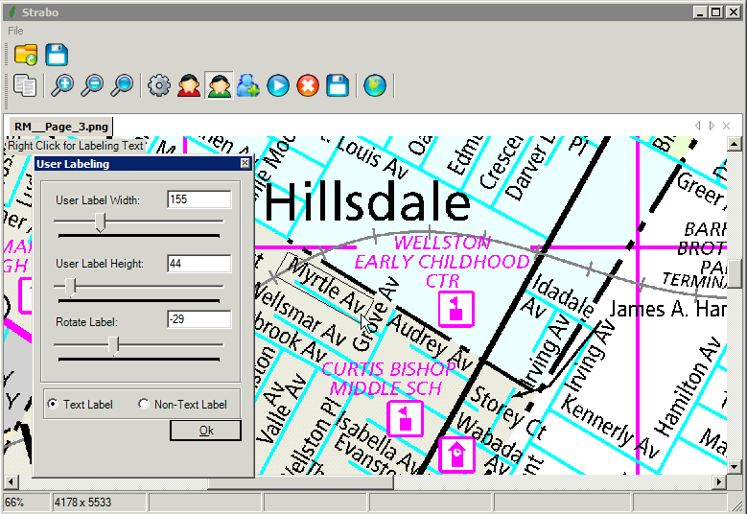
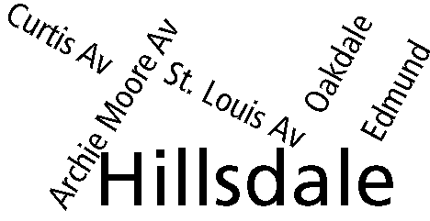
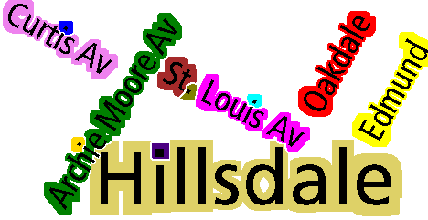
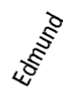
Extracting the text layer from a map image
Extracted text layer (raster)
Identifying text strings
Name | Lat./Long.
Hillsdale | 38.68456, -90.2873
Curtis Av | 38.68653, -90.2907
Archie Moore Av | 38.68484, -90.2901
Oakdale | 38.68538, -90.28511
… | …
Tesseract OCR
Edmund
Rotating every string to horizontal
Geonames database
Recognizing string images
Notes:
The overall approach to extract the text on a map is first to extract the raster layer of the text, identify the individual text strings, rotate those strings to horizontal, run a commercial OCR product on the rotated text string, and build a database with the recognized text, the lat/long coordinates on the map, and the rotation of the original string.

Slide 8
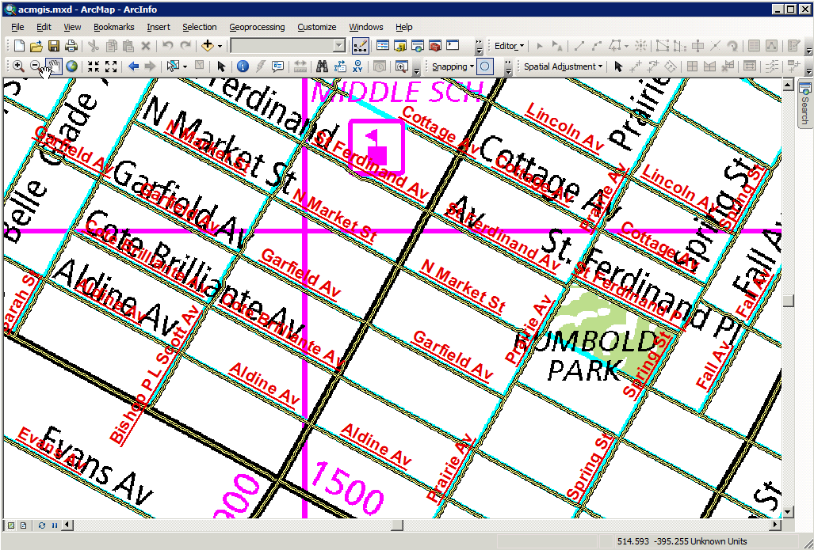
Experimental Results
Strabo correctly generated named road vector data with a 92.38% accuracy (824 correct named road segments)
Notes:
The final results is shown in ArcGIS where we overlay the extract roads on top of the original map.

Slide 9
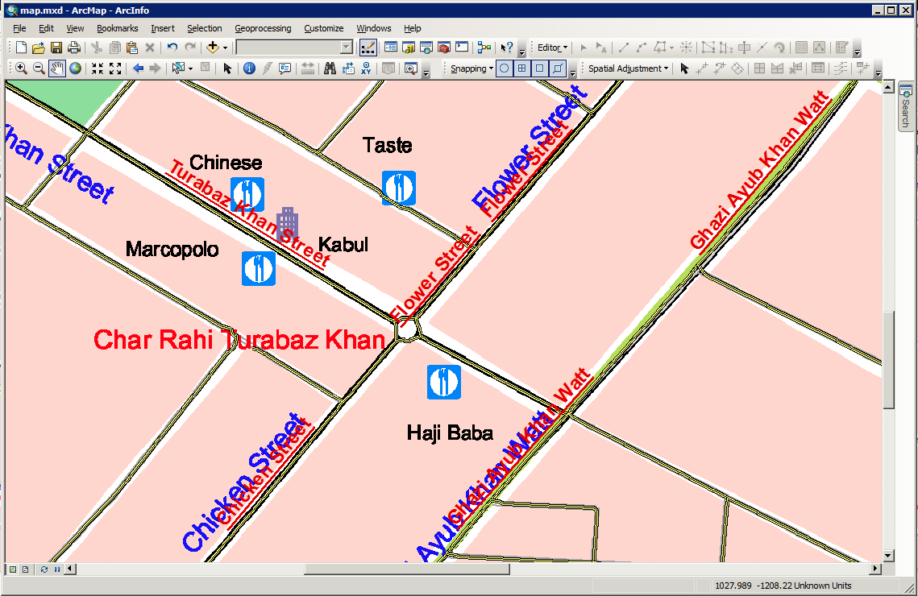
Experimental Results (Cont’d)

